Slide 1


Meal Planning web application for
iba Restaurant
BHANU PRAKASH,
VAMSHIDHAR REDDY
JOHANNES,
SHUMANCHENG

Slide 2


Agenda
1. Problem
2.Introduction
3.Technologies Used
4.Features
5.Demo
6.Conclusion

Slide 3

01
Problem
Only one person can edit the excel list at a time
Kitchen:
- Need to be able to fill out the meal name
- Need to be able to see the total amount of meals order
- Need to know how much money in total
Employees:
-Need to be able to see the menu for a week
- Need tobeabletoadd meals for guests
-Needtobeabletodelete the meal before certain day

Slide 4
02
Introduction
(1) Two interfaces
ForEmployee
For Kitchen Crew
(2) Multipleoptionswebsite to access easily

Slide 5

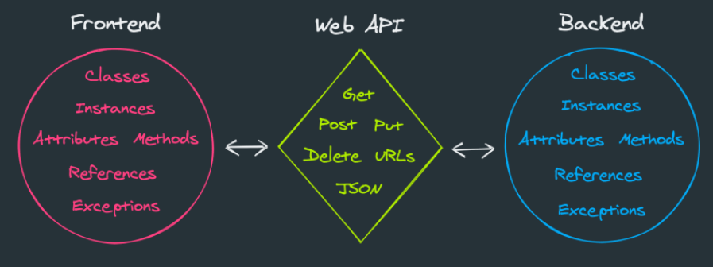
03
Technologies Used
VS code
Frontend:
(1) Angular11
(2) Type Script
Backend
(1) Python Flask
(2) Database:MongoDB

Slide 6
04
Features
Very clean and Simple UI
No lags
Customized Meal Scheduling
Convenient Ordering System
Used titles instead numbering

Slide 7
05
DEMO
Frontend
Backend

Slide 8
06
Conclusion
Overall this application can be used without prior knowledge
Our web application provides a simple and easy-to-use way for iba employees to plan and organize their meals for the week.
The application provides a simple overview for the Kitchen-Team for both food ordering and billing
Configurable to use the companies Single-Sign-On(No need for more passwords)

Slide 9

Github
Link

Slide 10
Q & A

